Slide 1

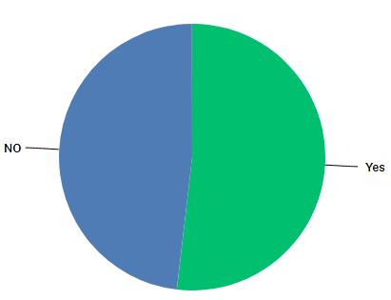
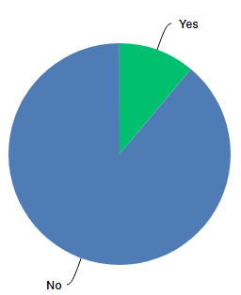
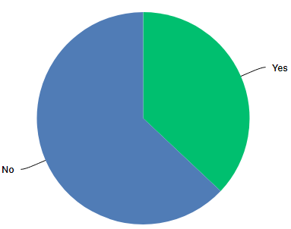
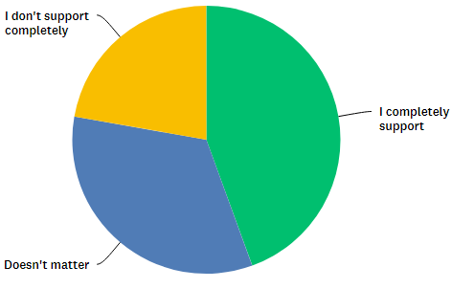
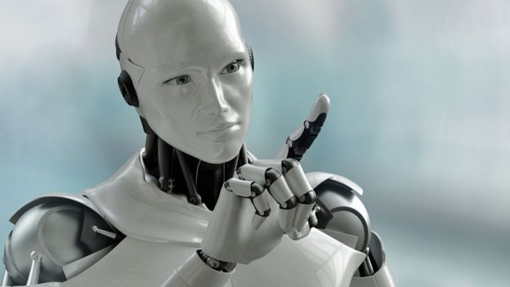
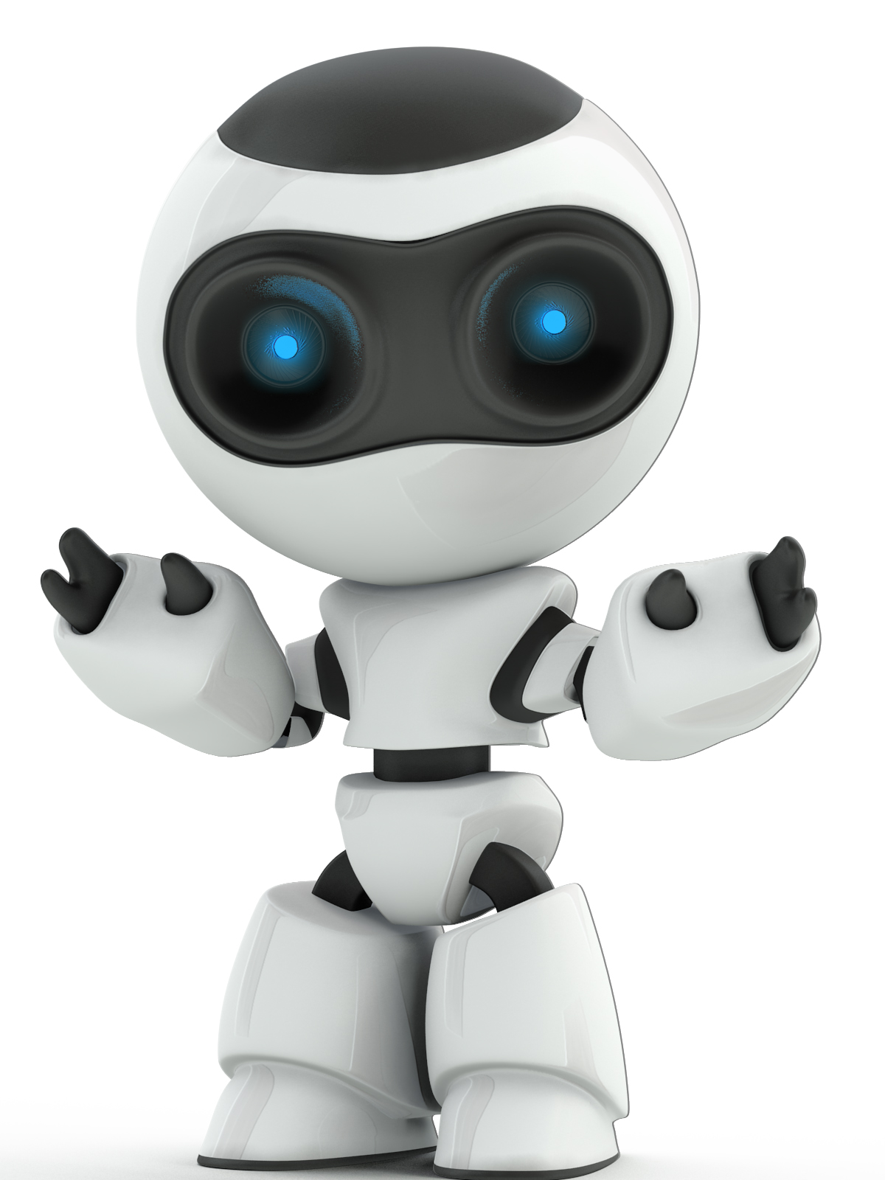

Robots As intelligent as humans
Elham AlBaroudi, Sara Alsaweed, Sara Alshughri, Nura AlRayes.
Abstract
Case With
Result
In this age of technology, traditional norms are being replaced by modern day innovations resulting in a change of life patterns and improved standards of living. A major innovation is the fast pace advancement is the robotics technology. New-generation robotics will open prospects for advancement in the standards of living. Robots can be directed to work in all sectors of human life, especially in risky areas. On the other hand, robots can be used as a destructive tool in wars by killing empathy and emotional relationships between humans. This study highlights the major advantages and disadvantages of robots entering our practical lives.
Robots are becoming physically stronger in processing plants with incredible accuracy, increase of profit, and adaptability.
The worldwide market has an incentive for mechanical frameworks worth USD 32 billion. The car division itself expanded their robots by 43% in just one year, from 2013-2014. This is an ideal opportunity to enter computerization.
The robot's joints utilize a combination of flexible actuators that empower it to control the amount of force on the arms at any given time. This makes simple robots such as Baxter, extremely safe for people to use.
Robots can do domestic jobs such as vacuum and wipe kitchen floor, clean drainages, act as a teacher for kids, provide home security etc. for friends and family.
In case of network failures or disasters, robots can transfer their information to the cloud technology. The possibilities of advanced personality back-ups and transferring/downloading information indicate that robots will be fit for surviving uncertainty.
A survey we made to justify the opinion upon robotics labor use and what do individuals think about the raise of artificial intelligence, the feedback that we received are shown in the pie chart. there is a misunderstanding in the acknowledgment of artificial intelligence , since the answer of the first question gave a moderate range between denying and agreement. In addiction, another question shows that the individuals aren't consciously aware of the benefits of robots. However it is shown clearly that the community lack the right education and enlightenment of what robots have incorporate to society, and as well as the danger behind them, that makes the product more dangerous to the norm and the ways to prevent them might be more difficult to approach.
Introduction
The purpose of this research is to understand the benefits of robots and areas that they would be useful compared to human labor. This research will also defend the arguments of robotic use in labor work and their expected outcomes.
There are 2 aspects to the argument - the extent that robots can benefit the work environment and the extent that humans can reach in robotic developments.
The impact of the changes in the industry when robots replace human beings can’t be determined, yet we can still imagine the change in quality of living that robots could provide.
Robots will take over tasks that will ease the burden of heavy work given to humans allowing them to focus more on other more effective activities. Studies show that robotics technology is already used extensively in many departments of medicine, architectural and governmental areas. But the question is whether it’s beneficial or harmful. And if it’s benefits outweigh its harms to human beings.
Q1: Are you familiar with artificial intelligence (AI)fields?
Q2: Do you think that we could live in a world that entirely depend on robots ?
Case Against
According to our survey, the majority think that Al can not lead to
real risk in future, and they accept to use the robot in their daily life.
First of All, as indicated by Stephen Hawking (2016), the advancement in artificial intelligence could create an automated world independent of human beings. He believed that there is no substantial contrast between what can be accomplished by a brain and a PC. But PCs can, in principle, imitate human knowledge and surpass it​.
Moreover, according to Wilson,S.(2016)in his article “How robots will change the world” the Artificial intelligence and robotics will lead to companies having less employees and workers because robots will replace human jobs Moshe Vardi, proffessor of computer science at Rice University in Texas said that
“Society needs to confront this question: if machines are capable of doing almost any work humans can do, what will humans do?”(para.1). Robots don’t need a salary and are inexpensive to hire along with being faster. As a result, most people will not find jobs and poverty will increase.
Finally, According to Ema , A.(2016), a survey for evaluating the Artificial Intelligence impact shows that Majority of people won't accept anyone besides humans for watching over babies. Moreover, people say that to make a decision related to life and other originative performances, are activities that can only be done by humans.
Q3: Most of AI films predicted that robots
will destroy human's race. Do you agree ?
Q4: What do you think about use of robots in our daily life?
Conclusions
The effectiveness of robots developing an artificial intelligence and autonomy was raised in this research. Robotics technology is safe as long as there aren’t any developments leading to global catastrophes. But it can’t be ignored as robots are gradually entering the workforce and almost all areas of life.
As said by Wilson, robots can’t think beyond human intelligence, so companies will always be dependent on humans for research and development. While Hawkins said that PCs can just imitate and surpass human knowledge but that is possible to an extent because a machine can’t think like a human. So, areas of research such as medicines can be identified where total control could be given to robots under human supervision with robot being a data provider making it easier for humans to build upon new developments. So, to settle the argument it has been agreed that critical decisions should be left in the human hands and robots shouldn’t be allowed big fatal decisions regarding life and death situations.
Other then that robotic are safely to say that they can operate in an advanced way to help human kind.
References

